Slide 1
Parallelization and Threading
Asst.Prof.Dr.Derya BİRANT
329 - Windows Programming

Slide 2
Contents
1
Parallelization Overview
2
Threading
3
Parallel Loops
4
Tasks
5
PLINQ (Parallel LINQ)

Slide 3
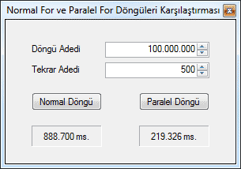
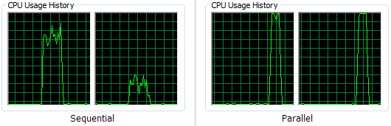
Why Parallelization?
CPU manufactures regularly released faster and faster processors. Speed increases, however, software need more power.
Manufacturers are instead concentrating on producing processors with multiple cores.
Multicore processers can process sections of code in parallel, resulting in some calculations being performed quicker and thus increasing application performance.
To take full advantage of multicore machines, however, code has to be designed to be run in parallel.

Slide 4
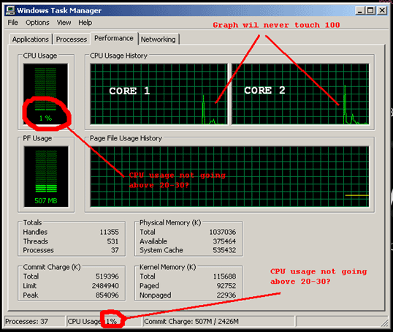
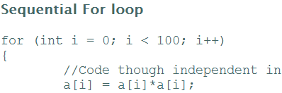

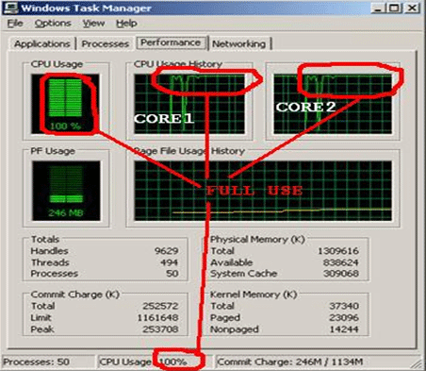


Slide 5
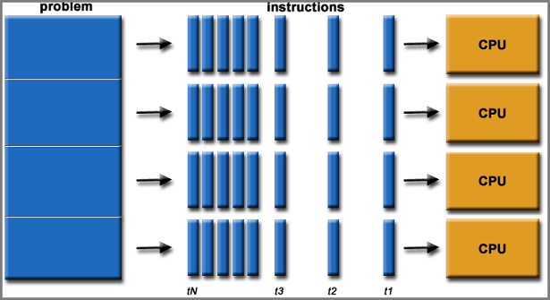
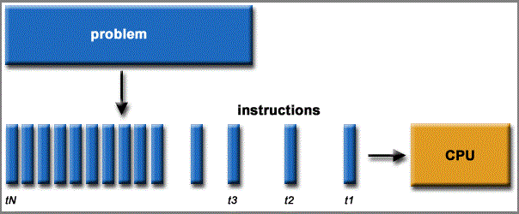
Parallelization Overview
Parallelism and threading are confusing
Concurrent!= Parallel
If your application is multithreaded is it running in parallel?
Probably not, applications running on a single CPU machine can appear to run in parallel because the operating system allocates time with the CPU to each thread and then rapidly switches between them.

Slide 6
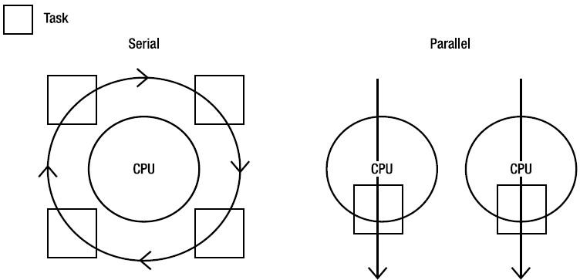
Multithreaded != Parallelization
Threads might not ever be actually running at the same time (although they could be), whereas in a parallelized application work is actually being conducted at the same time.

Slide 7
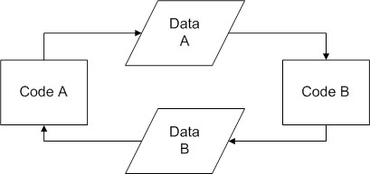
Application's Complexity
Threading and Parallelism Will Increase Your Application's Complexity
Race conditions: Race conditions arise in software when separate processes or threads of execution depend on some shared state.
Difficult to code and debug.
Deadlocks: A deadlock is a situation in which two or more competing actions are waiting for the other to finish, and thus neither ever does.
Thread starvation: Thread starvation can be caused by creating too many threads (no one thread gets enough time to complete its work because of CPU time slicing).
Environmental: Optimizing code for different machine environments (e.g., CPUs/cores, memory, storage media, and so on).

Slide 8
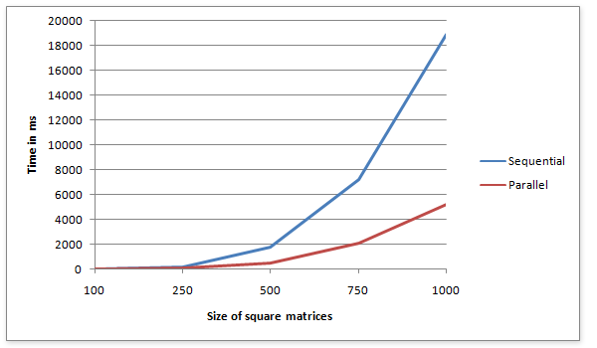
When Parallelization?
Can the Parallelization Features Slow Me Down?
Maybe.
In some cases, using the new parallelization features (especially on a single core machine) could slow your application down due to the additional overhead involved.
Creating too many threads, for example, can slow task completion because each thread is never given time to complete as the operating system rapidly switches between them.

Slide 9
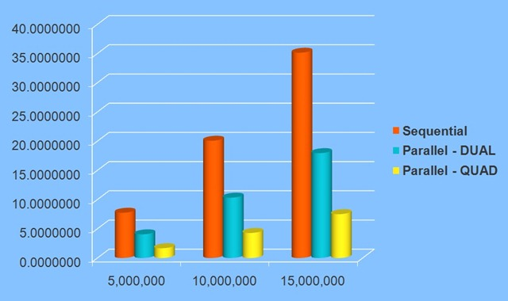
When Parallelization?
Some segments of code that will benefit from parallelization; and some that will not.
When each individual calculation is independent so can safely be run in parallel.
Code that is likely to benefit from being run in parallel will probably have the following characteristics:
  It can be broken down into self-encapsulated units.
  It has no dependencies or shared state.

Slide 10
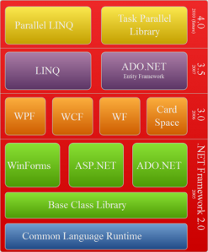
Parallelization in .NET 4.0
TPL (Task Parallel Library) ve PLINQ (Parallel LINQ) .Net Framework 4.0 ile gelen en önemli özelliklerdir.

Slide 11
Parallelization in .NET 4.0
.NET 4.0 enables developers to parallelize their code in an easy and consistent way.
Four main approaches:
  Threading
  Parallel Loops
  Tasks
  PLINQ (Parallel LINQ)

Slide 12






















Visual Studio 2010
Tools
Programming Models
Visual
Studio
IDE
.NET Framework 4
Visual C++ 10
Parallel
Debugger Tool Windows
Parallel LINQ
Parallel Pattern Library
Agents
Library
Task Parallel
Library
Data Structures
Concurrency Runtime
Data Structures
Concurrency Visualizer
ThreadPool
Task Scheduler
Task Scheduler
Resource Manager
Resource Manager
Operating System
Windows
Threads
UMS Threads
Managed
Native
Tooling

Slide 13
Threading
Multithreading is a mechanism for performing two or more tasks concurrently.
Threads running concurrently share the CPU (or CPUs) by using scheduling algorithms provided by the system.
Creating too many threads → can slow because each thread is never given time to complete as the operating system rapidly switches between them.
To avoid these issues,
  .NET implements a thread pool that has a bunch of threads up and running, ready to do your bidding.
  The thread pool also can impose a limit on the number of threads created preventing thread starvation issues.
  It provides additional cancellation and scheduling.

Slide 14
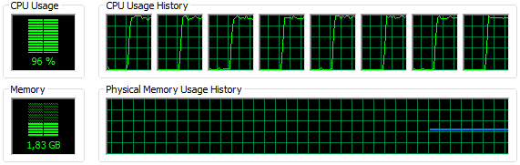
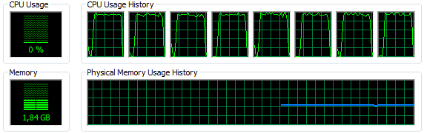


Multi-threading on Multi-core Processors
The multi-core processors deliver better performance relative to their single-core predecessors through on multi-threading.
multi-threading
without multi-threading

Slide 15
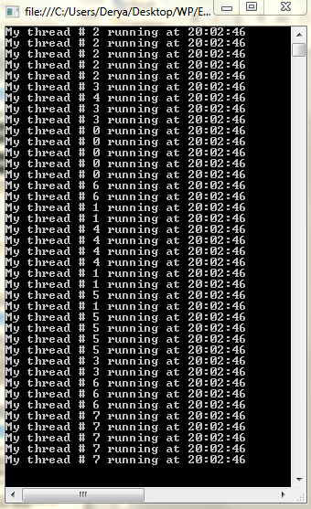

using System.Threading;
static void Main()
{
for (int i = 0; i < 8; i++)
{
Thread thread = new Thread(new ThreadStart(ThreadFunc));
thread.Name = "My thread # " + i;
thread.Start();
}
}
static void ThreadFunc()
{
String name = Thread.CurrentThread.Name;
for (int i = 0; i < 5; i++)
Console.WriteLine(name + " running at " +
DateTime.Now.ToLongTimeString());
}
Parallel
Serial
static void Main()
{
for (int i = 0; i < 8; i++)
ThreadFunc();
}
static void ThreadFunc()
{
String name = "1";
for (int i = 0; i < 5; i++)
Console.WriteLine(name + " running at " + DateTime.Now.ToLongTimeString());
}

Slide 16
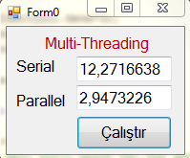
Multi-Threading Example
private static void RunInSerial()
{
for (int i = 0; i < 8; i++)
Work();
}
static Barrier MyBarrier = new Barrier(4);
private static void RunInParallel()
{
for (int i = 0; i < 8; i++)
{
Thread thread = new Thread(new ThreadStart(Work2));
thread.Start();
}
MyBarrier.SignalAndWait();
}
public static void Work()
{
for (int i = 0; i < 500000000; i++) { }
}
public static void Work2()
{
for (int i = 0; i < 500000000; i++) { }
MyBarrier.SignalAndWait();
}

Slide 17
Parallel Loops
One of the easiest ways to parallelize your application is by using the Parallel Loop construct.
Two types of loop can be run in parallel:
  Parallel.For()
  Parallel.ForEach()

Slide 18
Parallel.For()
Syntax
It generally accepts 3 parameters:
  0 is the counter for the start of the loop.
  100 lets the loop know when to stop.
  i=> our friendly lambda statement with the variable i representing
  the current iteration.
System.Threading.Tasks.Parallel.For(0, 100, i =>
{
... // do something
});

Slide 19
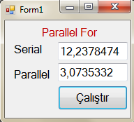
Example
The differences between running code in serial and parallel.
private void button1_Click(object sender, EventArgs e)
{
double serialSeconds = 0;
double parallelSeconds = 0;
Stopwatch sw = new Stopwatch();
sw = Stopwatch.StartNew();
RunInSerial();
serialSeconds = sw.Elapsed.TotalSeconds;
sw = Stopwatch.StartNew();
RunInParallel();
parallelSeconds = sw.Elapsed.TotalSeconds;
textBox1.Text = serialSeconds.ToString();
textBox2.Text = parallelSeconds.ToString();
}
private static void RunInSerial()
{
for (int j = 0; j < 8; j++)
Work();
}
private static void RunInParallel()
{
Parallel.For(0, 8, i =>
{
Work();
});
}
public static void Work()
{
for (int i = 0; i < 1000000000; i++) { }
}

Slide 20
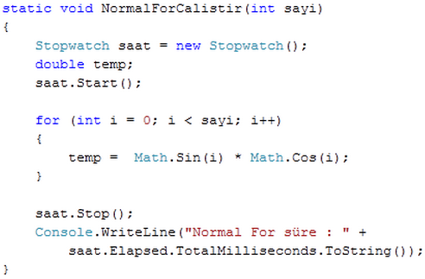
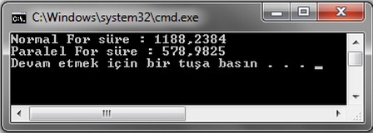
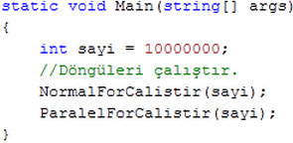
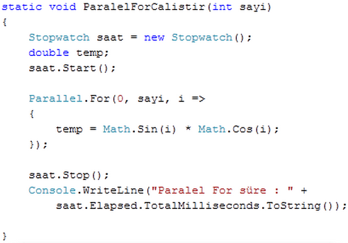

Slide 21
ParallelOptions
.Net framework allows you to specify options such as the number of cores to use when running the loop in parallel by using the ParallelOptions class.
The following code limits the number of cores to use for processing to two.
ParallelOptions options = new ParallelOptions { MaxDegreeOfParallelism = 2 };
Parallel.For(0, 8, options, i =>
{
//do something
});

Slide 22
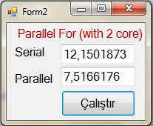
ParallelOptions
private static void RunInSerial()
{
for (int j = 0; j < 8; j++)
Work();
}
private static void RunInParallel()
{
ParallelOptions options = new ParallelOptions { MaxDegreeOfParallelism = 2 };
Parallel.For(0, 8, options, i =>
{
Work();
});
}
public static void Work()
{
for (int i = 0; i < 500000000; i++) { }
}

Slide 23
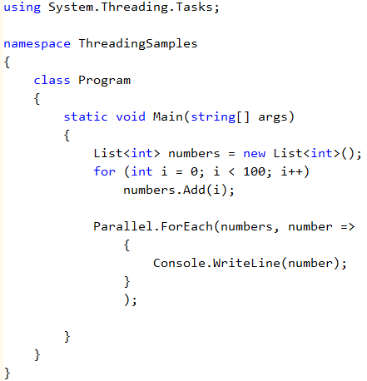
Parallel.ForEach()
Similar to the Parallel.For() loop, the Parallel.ForEach() method allows you to iterate through an object .
Example:

Slide 24
Parallel.Invoke()
The Parallel.Invoke() method can be used to execute code in parallel.
It has the following syntax:
3 tane ayrı çalıştır ve farkını bul ekran görüntüsü al.
Parallel.Invoke(() => Work(),
() => Work(),
() => Work());
public static void Work()
{
for (int i = 0; i < 500000000; i++) { }
}

Slide 25
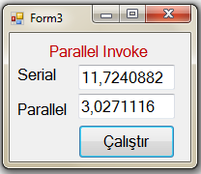
Parallel.Invoke()
private static void RunInSerial()
{
for (int j = 0; j < 8; j++)
Work();
}
private static void RunInParallel()
{
Parallel.Invoke(() => Work(),
() => Work(),
() => Work(),
() => Work(),
() => Work(),
() => Work(),
() => Work(),
() => Work());
}
public static void Work()
{
for (int i = 0; i < 500000000; i++) { }
}

Slide 26
Tasks
You can think of tasks as a wrapper for the thread pool and the preferred way of scheduling threads.
The existing thread pool methods will continue to work, but tasks are much easier to use and have additional functionality.
  Task.Start
  Task.Wait() and Task.WaitAll()
  Task.WaitAny()
  ContinueWith()
  Task.IsCompleted
  …

Slide 27
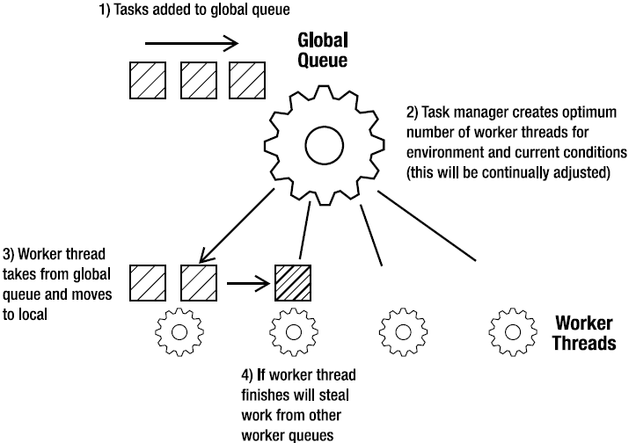
Overview of Task Manager

Slide 28
Creating a New Task
All the task functionality is found in the System.Threading.Tasks namespace.
The easiest way to create a task is with the Task.Factory.StartNew() method.
Another way to create a task is to pass the code you want run into the task’s constructor.
Difference: you have to explicitly start the task when using this method.

Slide 29
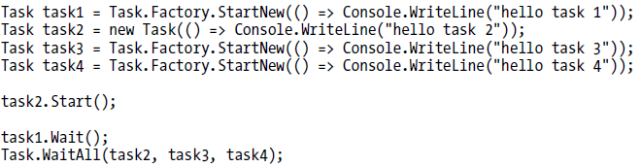
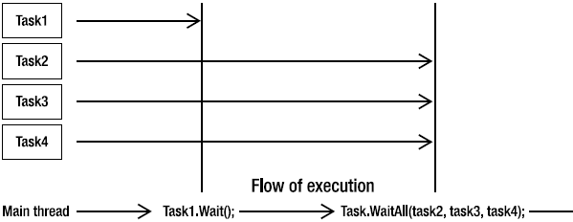
Task.Wait() and Task.WaitAll()
The Task.Wait() and Task.WaitAll() methods allow you to pause the flow of execution until the tasks you specify have completed their work.

Slide 30

Task.IsCompleted
It returns a Boolean value indicating whether the task has completed its work.

Slide 31
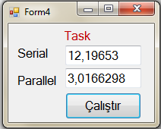
Task
private static void RunInSerial()
{
for (int j = 0; j < 8; j++)
Work();
}
private static void RunInParallel()
{
Task[] tasks = new Task[8];
for (int i = 0; i < 8; i++)
tasks[i] = Task.Factory.StartNew(() => Work());
Task.WaitAll(tasks);
}
public static void Work()
{
for (int i = 0; i < 500000000; i++) { }
}

Slide 32
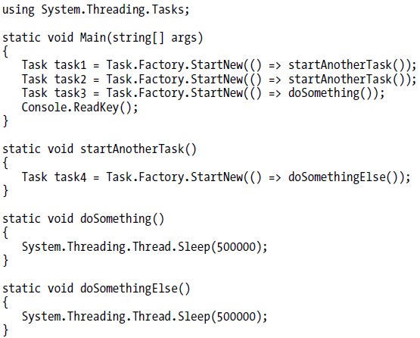
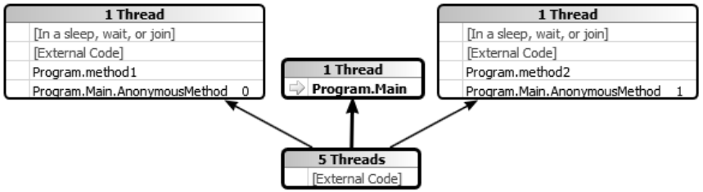
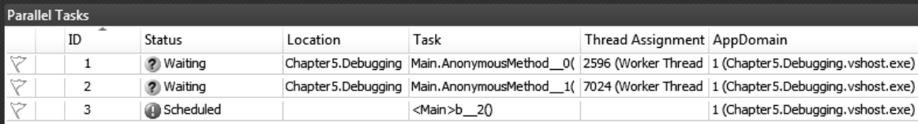
Parallel Debugging Enhancements
When the breakpoint is hit on the main menu, go to Debug →Windows →Parallel Tasks
.Net Framework 4.0 enables you to visualize task details

Slide 33
Different Parallelization Approaches

Slide 34




















PLINQ (Parallel LINQ)
PLINQ is the parallelized version of LINQ to objects and supports all existing LINQ operators and functionality with a few new options.
int[] input = new int[] { 1, 6, 3, 8, 9, 5, 2, 7 };
bool[] output = input.AsParallel().Select(x => IsPrime(x)).ToArray();
input:
output:
1
F
6
F
3
T
8
F
…
…
2
T
7
T

Slide 35
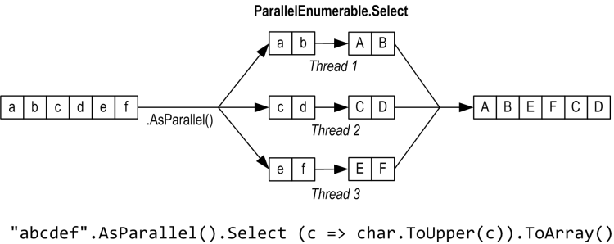
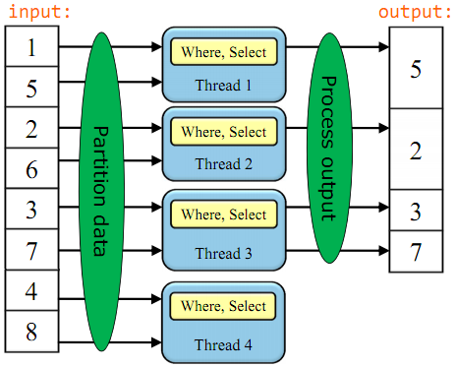
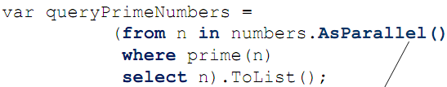
PLINQ (Parallel LINQ)

Slide 36
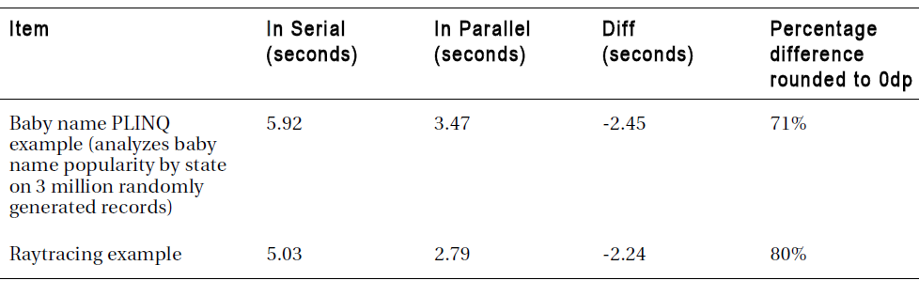
Sequential vs. Parallel
The main aim of parallelization is to increase an applications performance.
Comparison of parallelization effects
// SEQUENTIAL QUERY
_sequentialQuery =
from b in _babies
where b.Name.Equals(_userQuery.Name,
StringComparison.InvariantCultureIgnoreCase) &&
b.State == _userQuery.State &&
b.Year >= YEAR_START && b.Year <= YEAR_END
orderby b.Year
select b;
// PARALLEL QUERY
_parallelQuery =
from b in _babies.AsParallel().WithDegreeOfParallelism(numProcs)
where b.Name.Equals(_userQuery.Name,
StringComparison.InvariantCultureIgnoreCase) &&
b.State == _userQuery.State &&
b.Year >= YEAR_START && b.Year <= YEAR_END
orderby b.Year
select b;

Slide 37

See you next week!
Asst.Prof.Dr.Derya BİRANT
329 - Windows Programming

